Slide 1

B-SPLINES-BASED SOLUTIONS OF DIFFERENTIAL EQUATIONS IN BIOENGINEERING: MOTION MONITORING AND IMAGE PROCESSING APPLICATIONS
Bachelor’s thesis
Degree in Biomedical Engineering
Author: Antonio Manuel Ramírez Márquez
Tutor: David Casillas Pérez
Co-tutor: Sara García de Villa
01/16

Slide 2
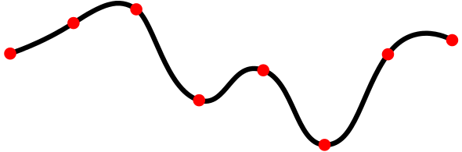
Introduction
Framework to provide solutions to differential equation in the field of bioengineering.
Spline:
Bioengineering applications:
Estimate human motion in rehabilitation.
Represent pre-operative models as splines.
02/16

Slide 3
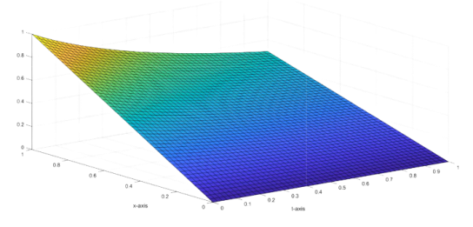
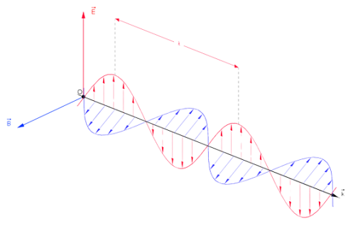

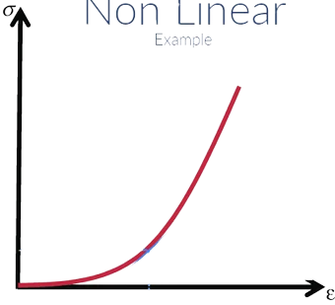
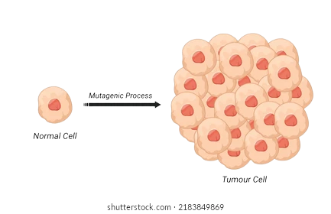
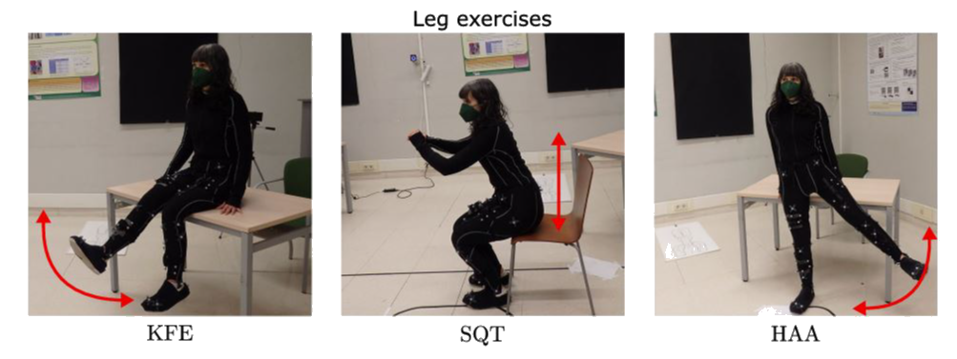
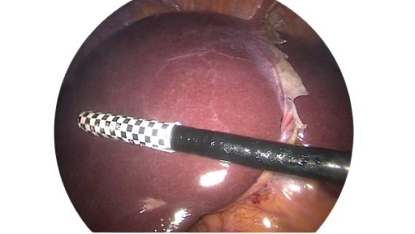
Objectives
1
2
The methodology is scalable in term of variate nature.
The methodology is scalable to systems of equations.
3
4
The methodology is scalable to non-linear equations.
To determine good choice in the process decisions.
5
6
To estimate tumour cells proliferation.
To estimate orientation and human motion from IMUs.
7
To represent a preoperative model as a spline.
03/16

Slide 4
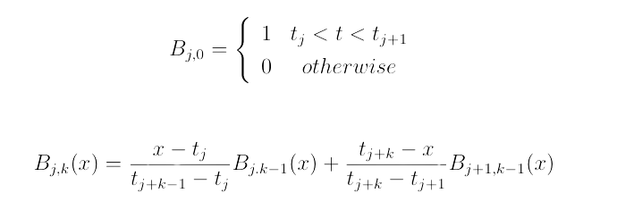
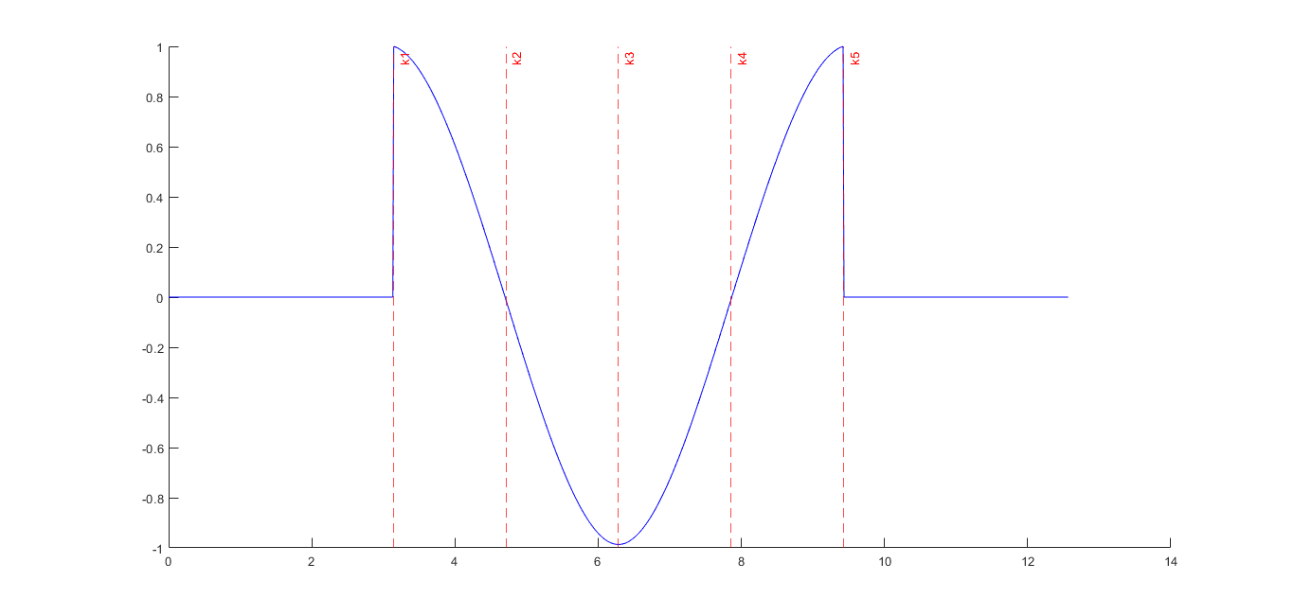
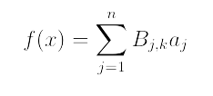
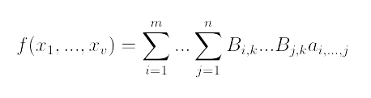
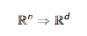
About splines
Smoothness
Knots: (k1, k1, k1, k1, k2, k3, k4, k5, k5, k5, k5)
Tensor product splines
04/16

Slide 5
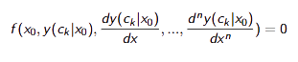
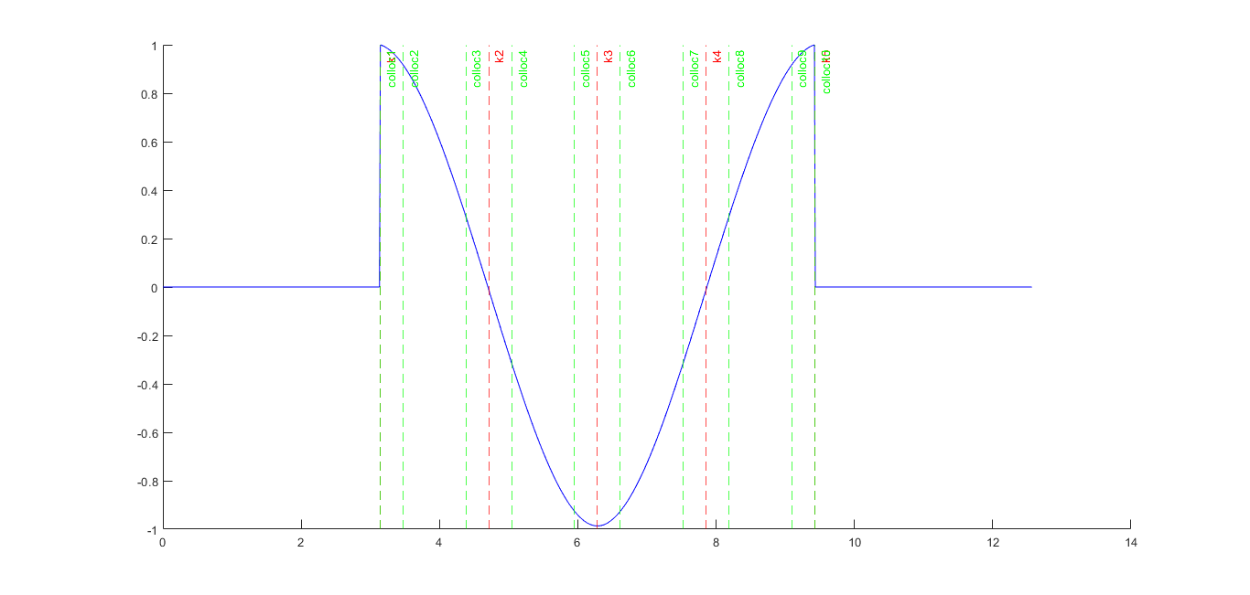
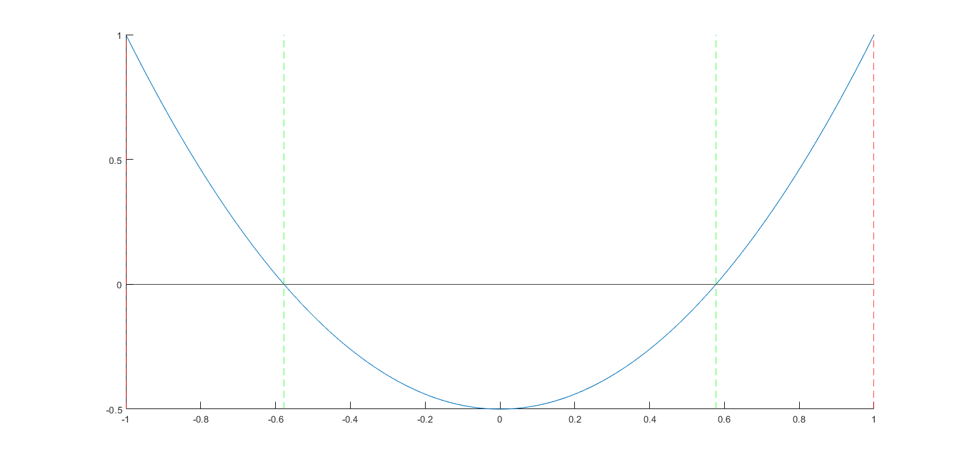
Collocation methods
Spline design
Order
Knots sequence
Domain
Smoothness
Legendre polynomial
05/16

Slide 6
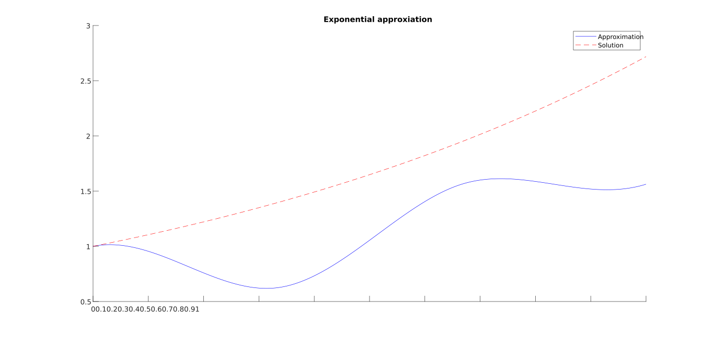
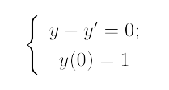
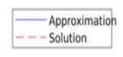
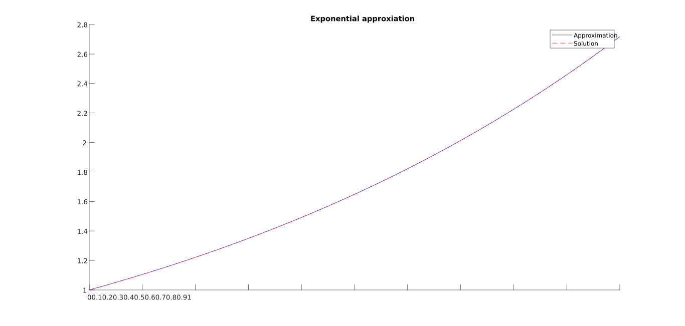
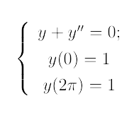
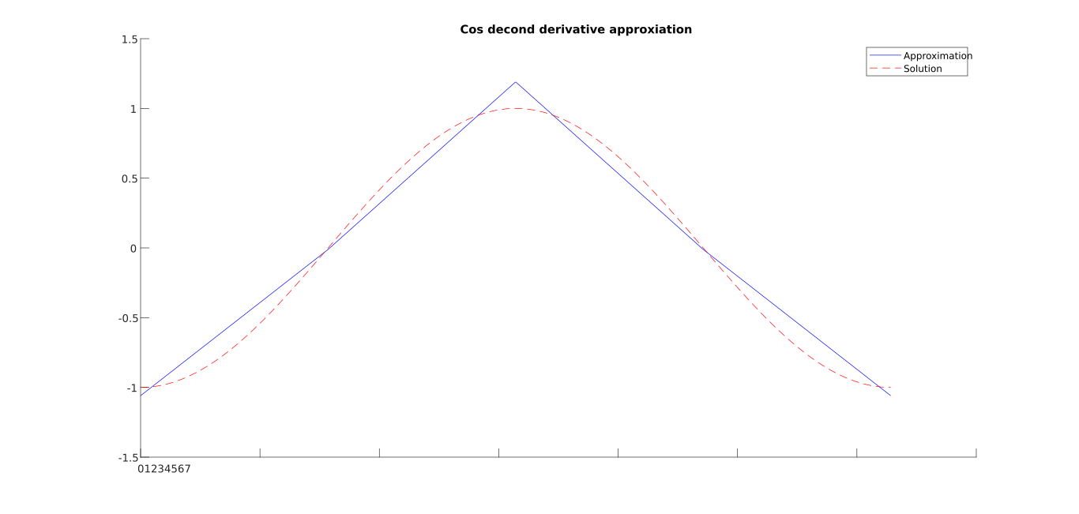
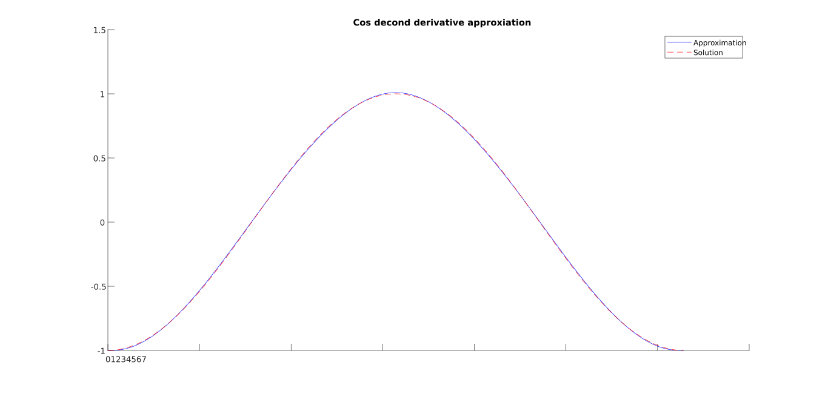
Decisions and impact
Best choices
Collocation points at Legendre Quadrature
5 breaks per sin cycle
4 collocation points per sub polynomial
Sixth-order spline
06/16

Slide 7
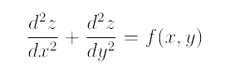
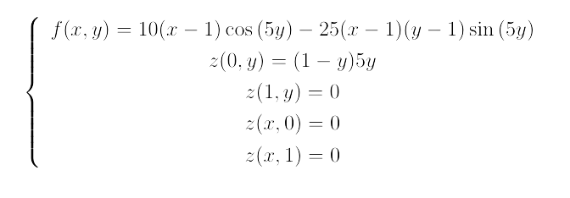
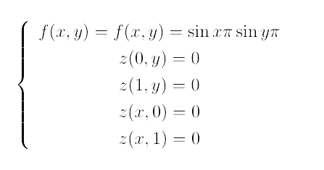
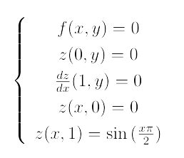
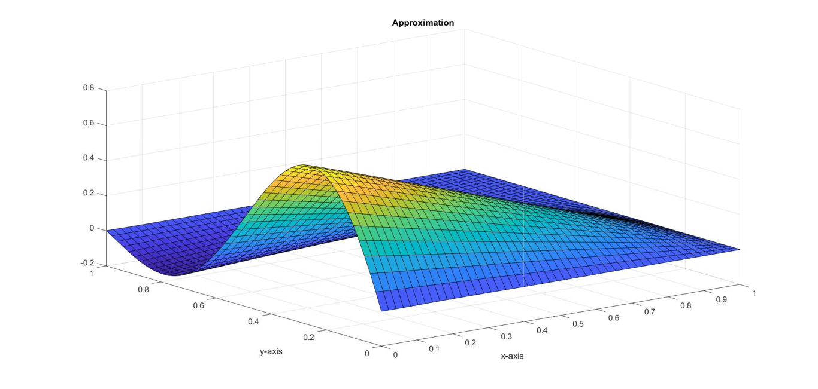
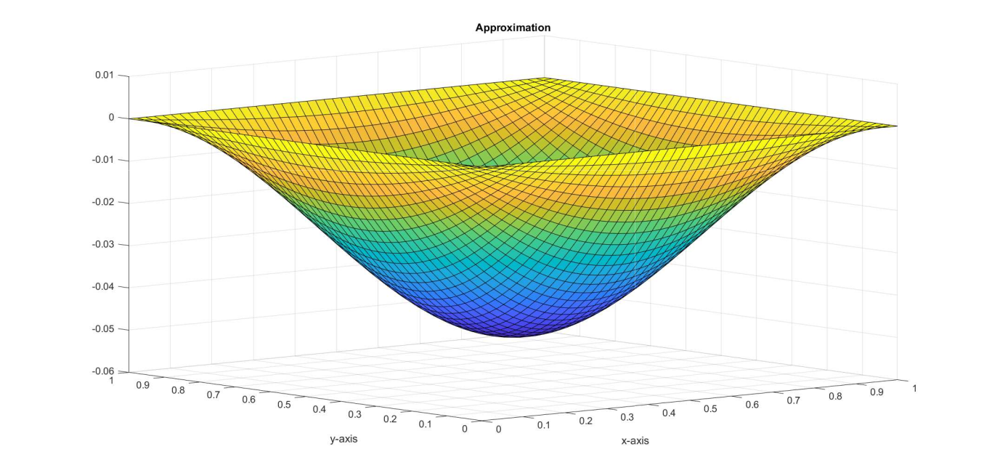
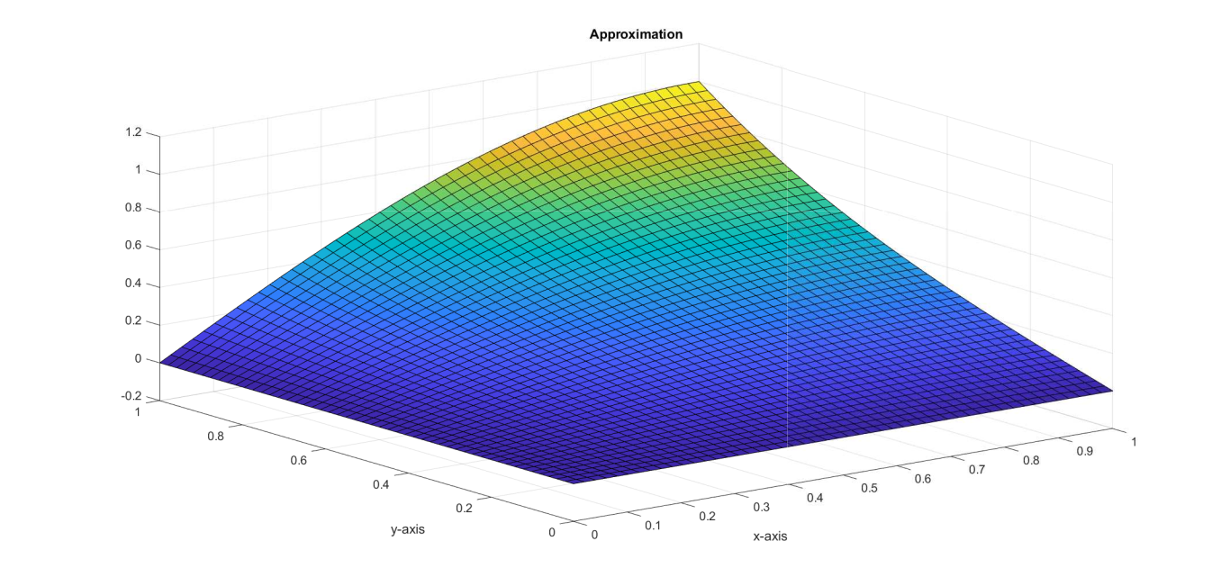
Multivariate splines
Laplace equation
Multivariate collocation
Cartesian grid of the collocation sites of each variable.
Collocation as Cartesian product of the univariate collocation.
07/16

Slide 8
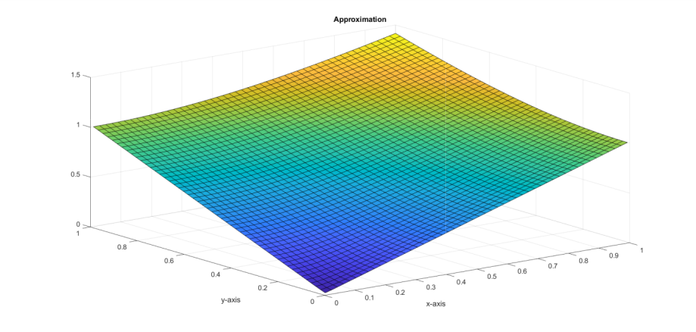
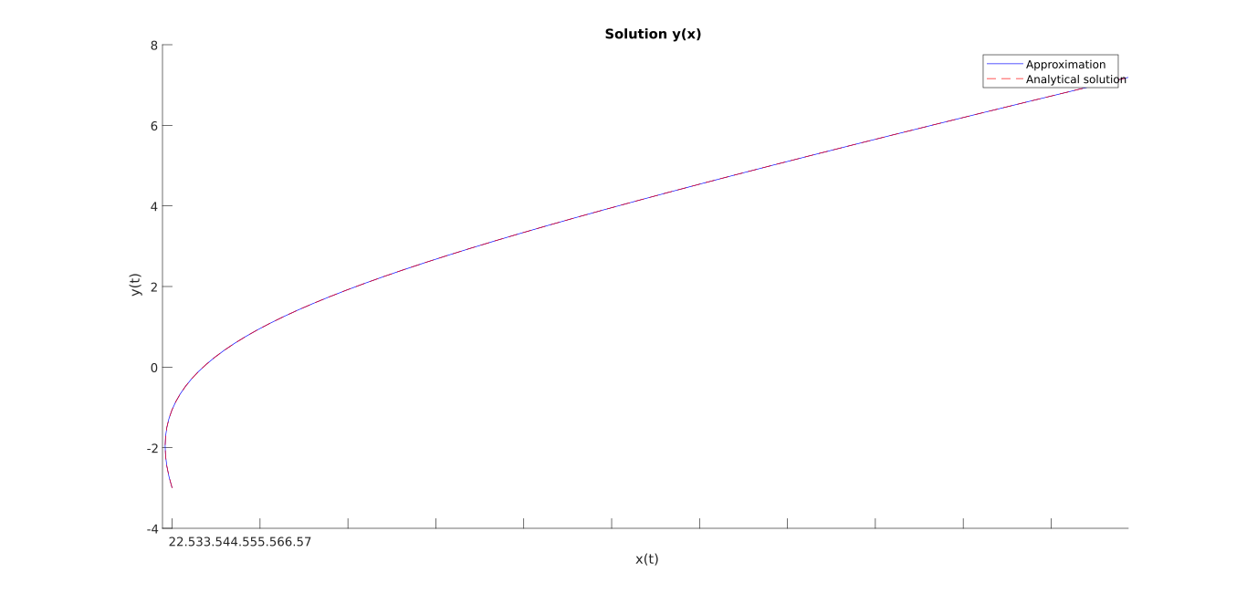
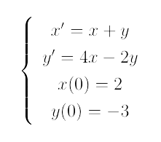
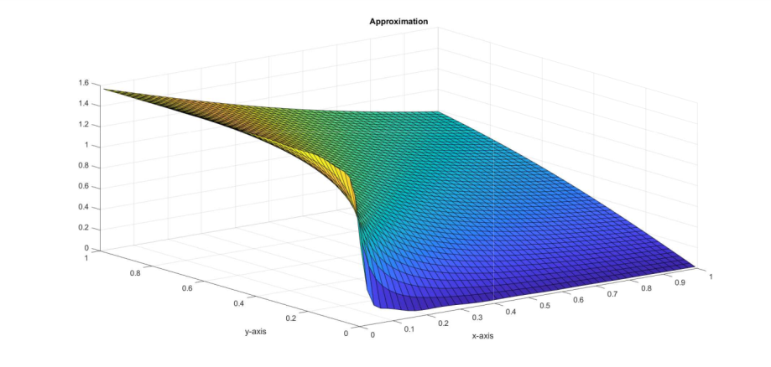
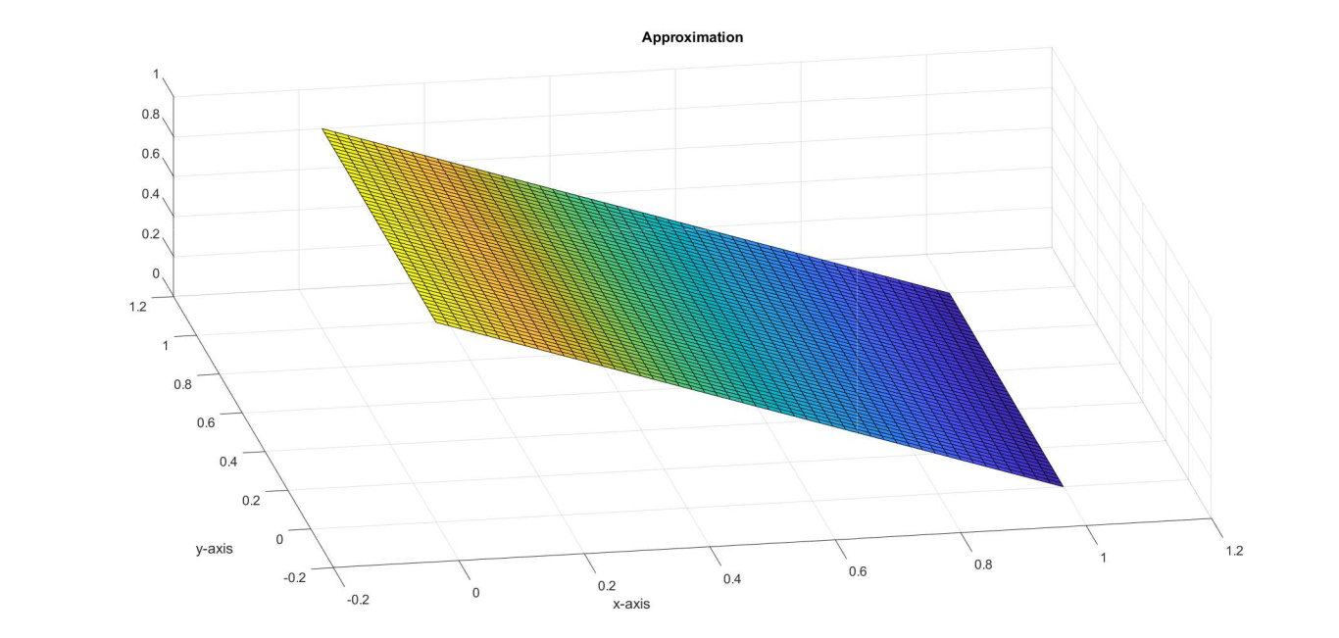
Multidimensional splines
System of equations and domain outcome
x(t)
y(t)
08/16

Slide 9
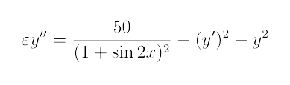
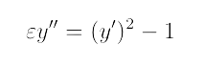
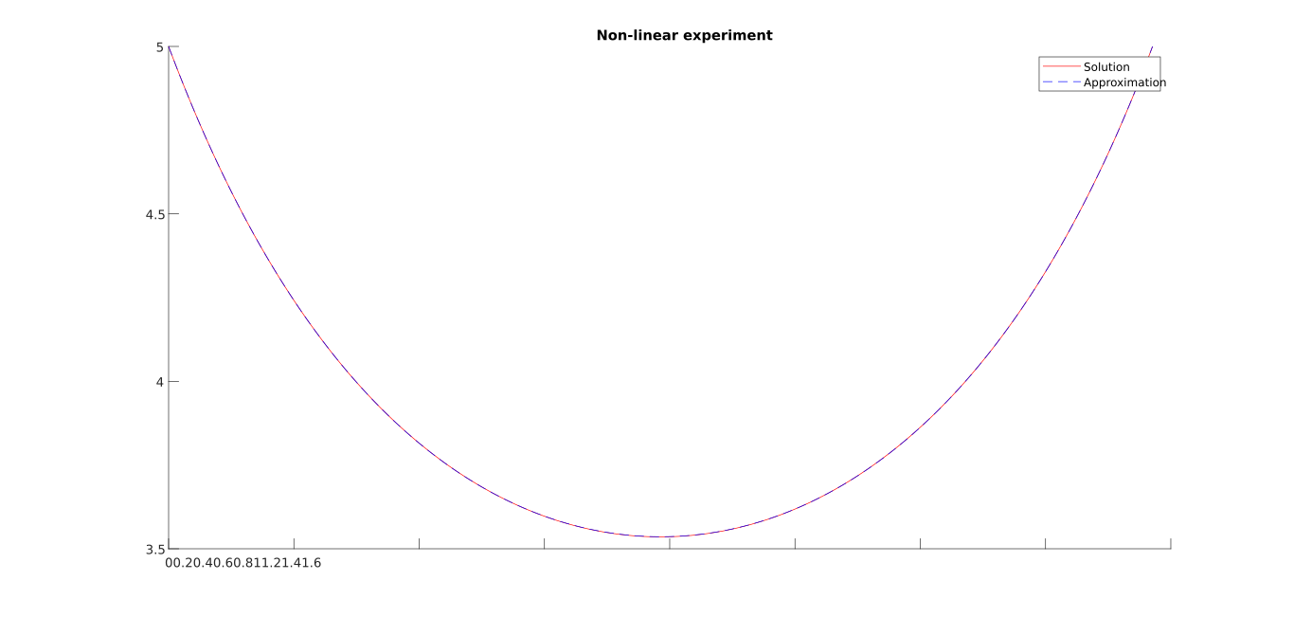
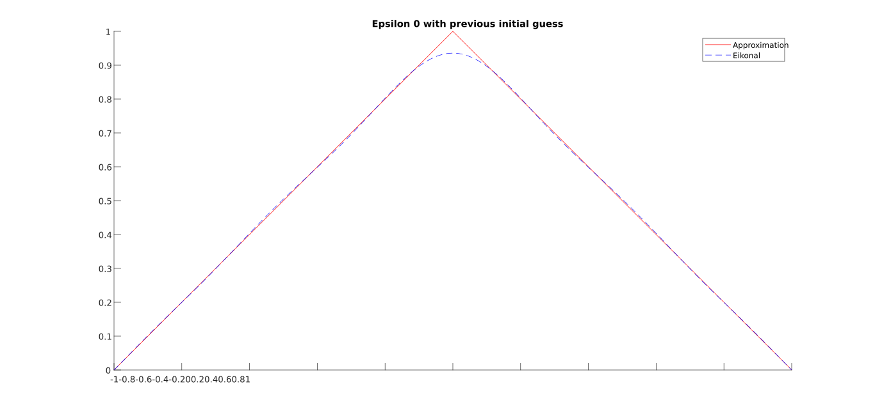
Non-linear DE
A linear term that is one order higher than the order of the differential equation is introduced to it.
The method consists on applying the Newton method to that equation.
Non-viscous approach
Viscous approach
The viscosity term is set to zero.
The viscosity term is set.
Non-linear
Eikonal
09/16

Slide 10
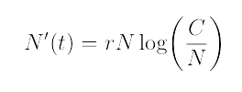
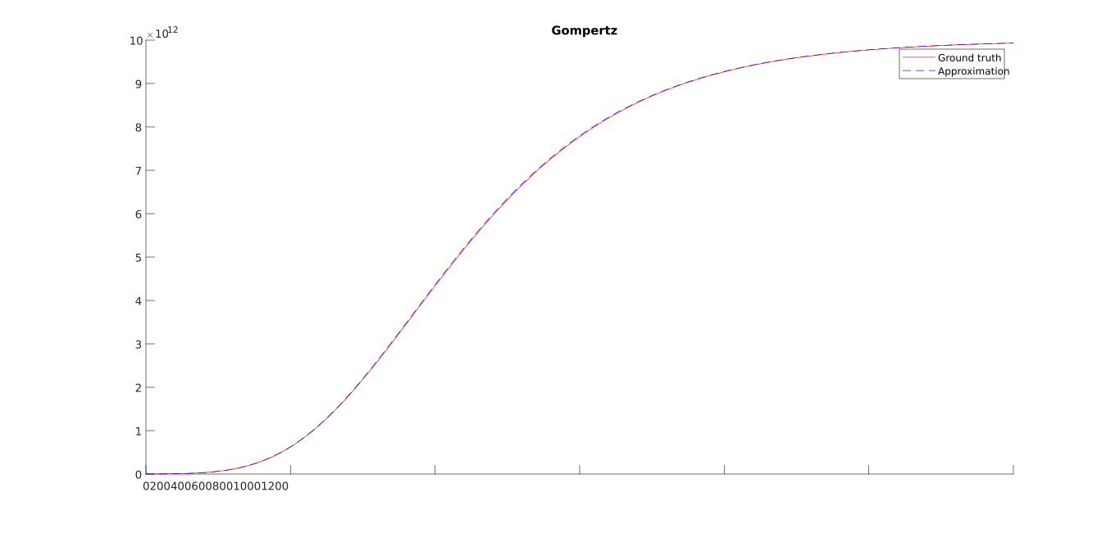
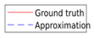
Gompertz model
Estimate the number of cells depending on the time of a tumour in angiogenesis stage.
It depends on the initial number of cells, the
intrinsic growth rate and the carrying capacity.
Gompertz
Parameters
N(0) = 1109 cells
r = 0.006 cells/t
C = 11013 cells
10/16

Slide 11
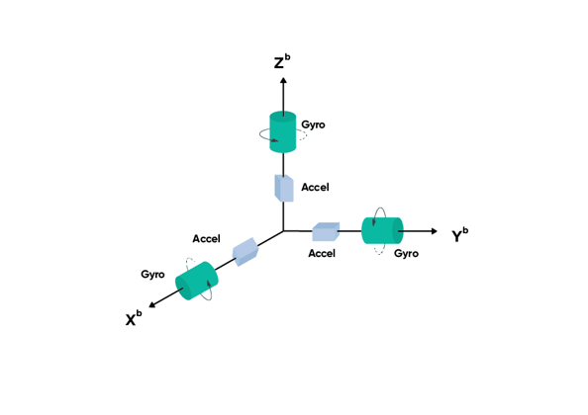
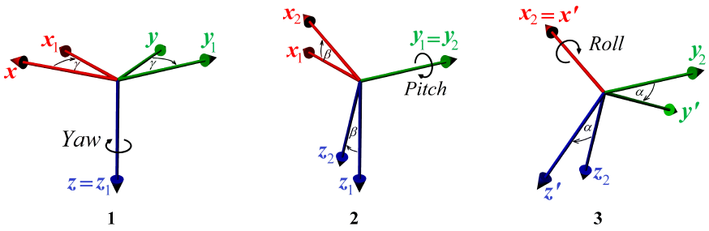
Motion monitoring
Inertial Measurement Unit (IMU):
Euler angles:
11/16

Slide 12
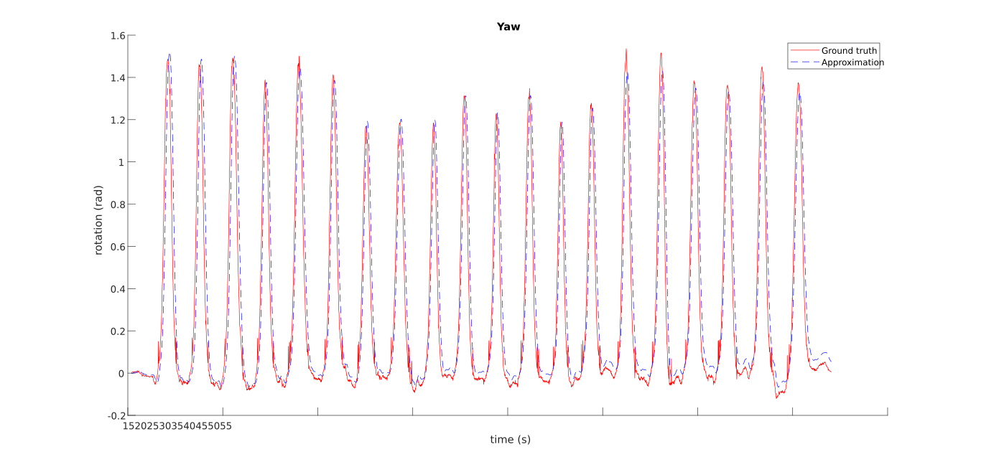
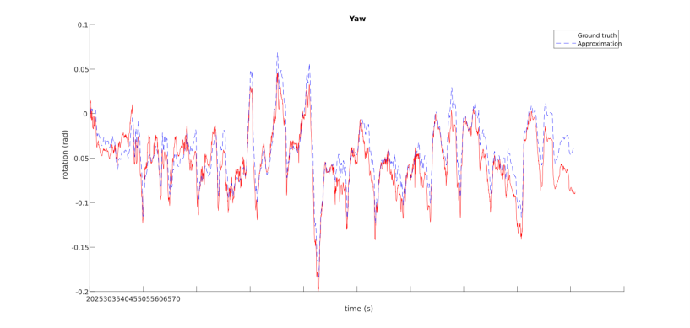

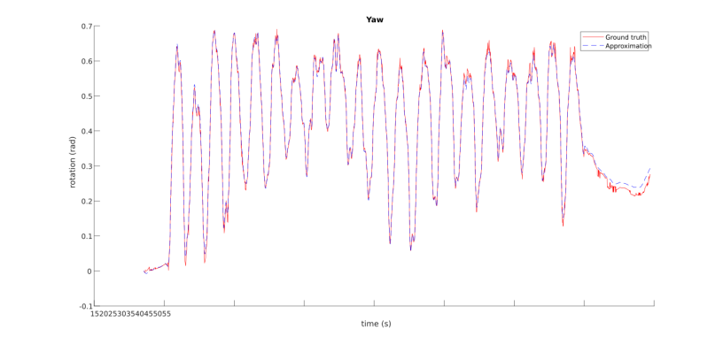
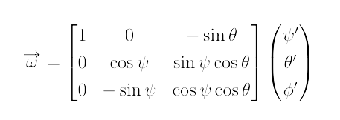
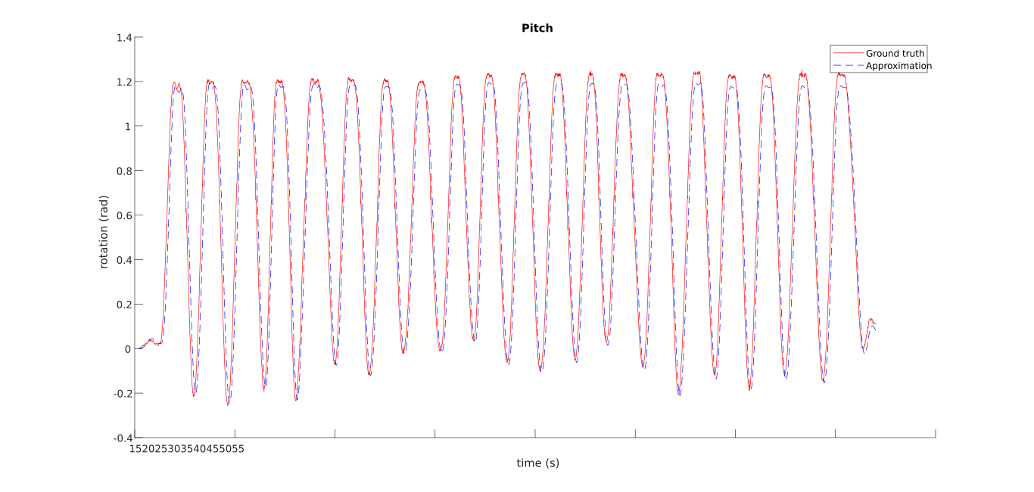
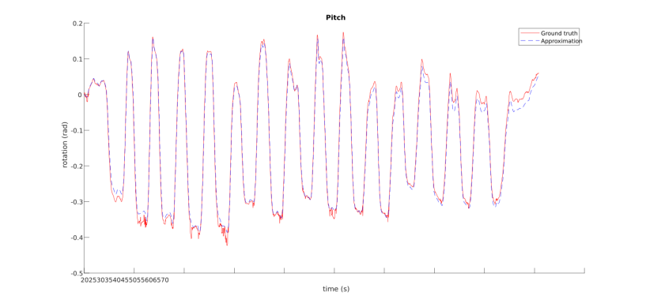

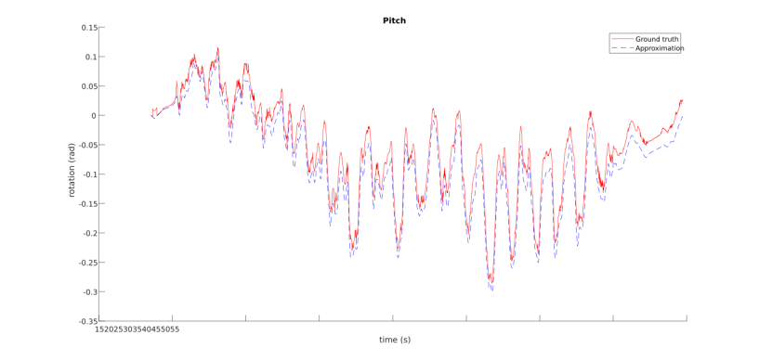





Orientation results
KFE
SQT
HAA
KFE
SQT
HAA
KFE
SQT
HAA
12/16

Slide 13













Motion results
KFE
SQT
Z
HAA
KFE
SQT
Y
HAA
KFE
SQT
X
HAA
13/16

Slide 14






Image processing
Preoperative model
Spherical coordinates
Spline of the radious
Tumour 1
Tumour 3
Tumour 2
Tumour 4
14/16

Slide 15
Conclusions and SDGs
1
2
The method is scalable to multivariate function, systems and non-linear equations.
It is determined a good criteria for different choices including the order, the collocation sites, the viscosity, etc.
3
4
The estimation of the orientation is satisfactory and the human motion in the KFE exercise.
The preoperative model of tumours are successfully represented as differentiable splines.
SDGs: Goal 3: Good health and well-being
Non-communicable diseases
Universal health coverage
Health risk management
15/16

Slide 16

Future lines
B
A1
We must evaluate the motion estimation including the time requirements.
To provide a close path framework is needed for the circular bases domain in the preoperative tumour models.
A2
It is needed to improve the determination of the ridge parameter in the displacement estimation.
Open path
Closed path
16/16

